Slide 1



REVENUE METRICS
PROJECT

Slide 2

AGENDA
01
PROJECT OVERVIEW
02
TECHNOLOGY TOOLS
03
KEY METRICS
04
PROJECT TIMELINE
05
KEY INSIGHTS
06
RECOMMENDATIONS
07
PROJECT CHALLENGES
AND SKILLS GAINED

Slide 3




PROJECT OVERVIEW
Description: The Revenue Metrics Analysis Dashboard is designed to track key revenue indicators, identify trends, and analyze factors influencing revenue generation.
Objective: The main goal of the project is to develop a dynamic dashboard for analyzing revenue metrics.
Purpose: The dashboard will empower stakeholders with actionable insights derived from comprehensive data analysis.

Slide 4





TECHNOLOGY TOOLS
DBeaver
PosgreSQL
Tableau Public
Managed PostgreSQL databases using DBeaver to ensure data integrity and accessibility.
Implemented complex SQL queries to extract insights on monthly recurring revenue (MRR), paid users, and other metrics, contributing to comprehensive revenue analysis
Utilized Tableau Public to develop visually engaging dashboards showcasing revenue metrics and trends.

Slide 5

KEY METRICS
DBeaver
MRR - Sum of revenue_amount_usd for each month where revenue_amount_usd > 0, grouped by month.
New MRR - Sum of revenue_amount_usd for New Paid Users each month.
Paid Users - Count of unique user_id for each month where revenue_amount_usd > 0.
New Paid Users - Count of unique user_id appearing for the first time in the current month.
Churned Users - Count of unique user_id from the previous month that are absent in the current month.
Churned Revenue - Sum of revenue_amount_usd for Churned Users from the previous month.
Expansion MRR - Increase in MRR in the current month compared to the previous month due to users who increased their payments.
Contraction MRR - Decrease in MRR in the current month compared to the previous month due to users who decreased their payments.
Tableau Public
ARPPU - MRR divided by Paid Users for each month.
Churn Rate - Churned Users divided by Paid Users of the previous month.
Revenue Churn Rate - Churned Revenue divided by MRR of the previous month.
Customer Lifetime (LT) - Average number of months between the first and last payment for each user_id.
Customer Lifetime Value (LTV) - Average sum of revenue_amount_usd over the entire period for each user_id.

Slide 6
PROJECT TIMELINE
The project started on April 15, 2024, and is scheduled to be completed by April 29, 2024.

Slide 7

KEY INSIGHTS
MRR
PAID USERS
NEW PAID USERS
BACK FROM CHURN USERS
MRR exhibited fluctuating patterns over the observed months, reaching its peak in October 2022 at $9,344 and experiencing a slight decline in subsequent months.
The number of paid users gradually increased from March to October, peaking at 199 users in October. However, a significant drop occurred in December, possibly due to churn.
New paid users were consistently onboarded each month, contributing to MRR growth. Notably, July and August saw a spike in new paid users, coinciding with expansions in MRR.
November and December witnessed significant numbers of users coming back from churn, positively impacting MRR.
CHURN ANALYSIS
EXPANSION CONTRACTION MRR
ARPPU
LT & LTV
Churned users and churned revenue increased over time, indicating a proportion of users discontinuing their subscriptions. December witnessed a notable churn event, leading to a substantial negative impact on MRR.
Despite fluctuations in other metrics, ARPPU emained consistent throughout the observed period, indicating stable revenue generation from each paying user.
LT ranged from 6.6 months in April to 2.6 months in November, indicating fluctuations in customer engagement duration.
Correspondingly, LTV showed a general decreasing trend, suggesting potential challenges in retaining high-value customers over time.
Despite fluctuations, expansion MRR outpaced contraction MRR in most months, contributing positively to overall revenue growth.

Slide 8
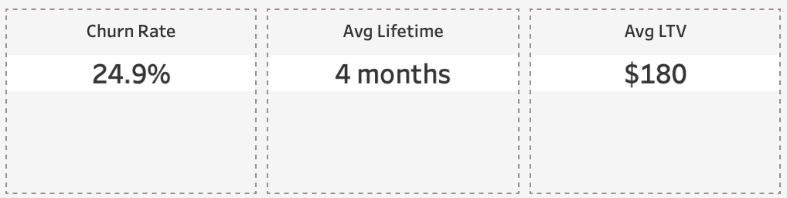
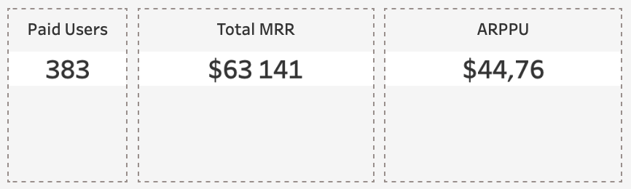

STATISTICS
The data reveals fluctuations in Monthly Recurring Revenue and Paid Users, with intermittent growth and declines. Average Revenue Per Paid User remains stable, while Churned Users and Revenue fluctuate, indicating periods of customer attrition and revenue loss.

Slide 9

RECOMMENDATIONS
Develop predictive models that factor in game name and its popularity to anticipate revenue fluctuations. By analyzing player engagement with specific game titles, refine marketing tactics and content updates to drive sustained revenue growth.
Leverage predictive modeling to analyze how user language preferences impact revenue generation in the game. Tailor marketing efforts and in-game content based on language demographics to optimize monetization strategies.
Integrate user age data into predictive models to forecast revenue trends across different age groups. By understanding age-related spending behaviors, optimize game features and promotions to cater to diverse player demographics.
GAME-SPECIFIC PREDICTIVE ANALYTICS
LANGUAGE-DRIVEN REVENUE FORECASTS
AGE-BASED REVENUE PROJECTIONS

Slide 10

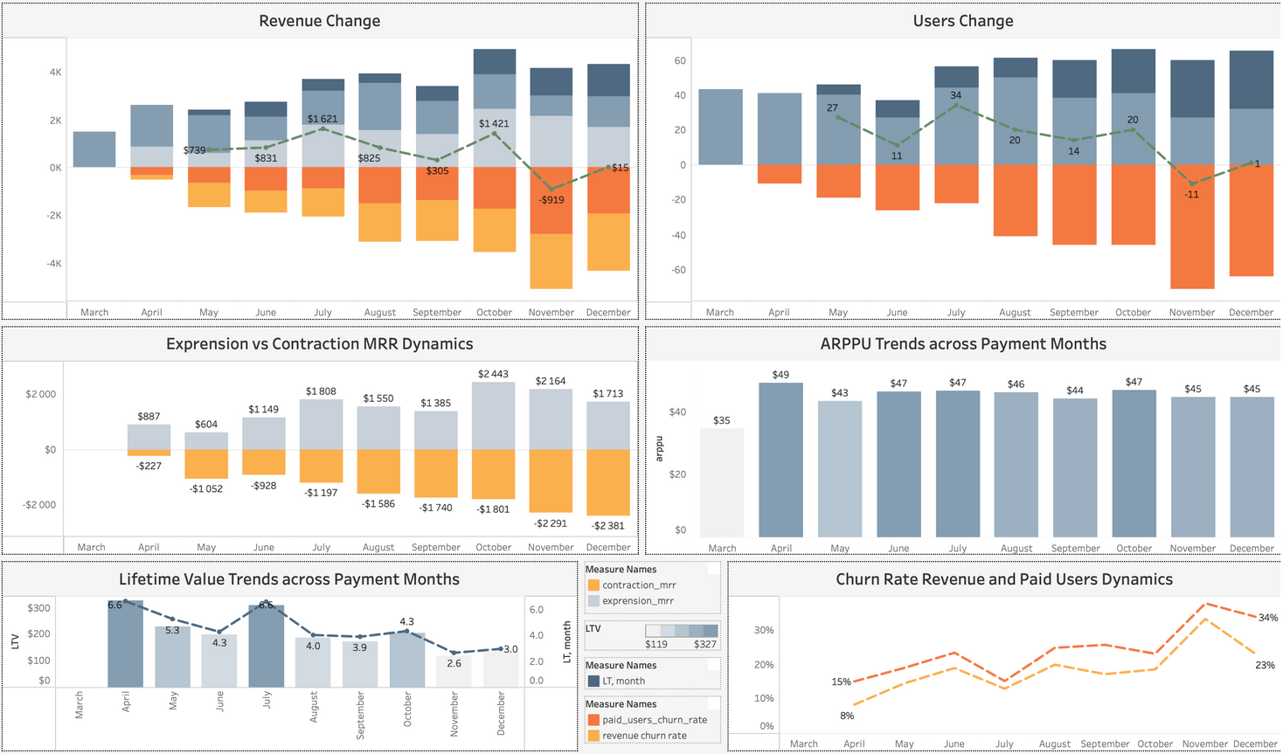
PROJECT CHALLENGES
In designing the dashboard, I focused on creating a clear and intuitive layout that would allow product managers to quickly identify key trends and insights.
I tried to create a user-friendly dashboard layout using bar charts, line graphs, and combined diagrams.
One challenge was accurately calculating churned users and revenue, which required precise analysis to track changes over time.
Additionally, visualizing these metrics effectively proved challenging, balancing depth with clarity to convey revenue trends accurately.

Slide 11


HARD SKILLS GAINED
This project deepened my understanding of recurring revenue metrics and their significance in evaluating the potential growth of product. I learned how to calculate and interpret metrics such as MRR, ARPPU, churn rates, and customer lifetime value, which are crucial for making informed business decisions.
Additionally, I improved my skills in data manipulation and transformation using SQL, as well as data visualization techniques in Tableau. I gained experience in creating interactive dashboards that allow users to explore data from multiple perspectives and extract meaningful insights.
Overall, this project provided me with a practical opportunity to apply my knowledge of data analysis, SQL, and data visualization to a real-world business scenario, preparing me for future challenges in the field of data analytics and product management.
CALCULATING PRODUCT METRICS
DATA MANIPULATION SKILLS
VISUALIZATION TECHNIQUES

Slide 12



OUR TEAM
Ira
Safonik
Yulia Malyovana
Yulia Volkova
Junior Data Analyst
Technical Expert
Client Manager

Slide 13



THANK`S FOR KNOWLEDGE

